Slide 1

Geoid Model
Importance
&
Usage
Survey of India
Misal Roshan Srivastava, SS, G&RB

Slide 2
Topics of Discussion
What is Geoid?
Why does anyone need a geoid model?
The many definitions of “height”
Geoid modeling
Current status and future directions

Slide 3
What is Geoid?
The primary reference for heights is the ‘Geoid’ which may be defined as:
An equipotential surface of the Earth’s gravity field which corresponds most closely with ‘mean sea level (MSL)’ in the ‘open oceans’, ignoring the semi-dynamic effects of ocean currents.
It extends continuously through the continents and, as such, is commonly used as the datum for topographic elevations in many countries.

Slide 4
Geoid Model
In simplest terms it is a datum which conforms to the laws of physics which says water must flow from higher potential to lower potential.
The ease & ability of GNSS (Global Navigation Satellite System) for e.g. GPS to derive fairly precise and accurate horizontal positions (x,y) is well known and fully established but derived ellipsoidal height (h) is not suitable for practical purposes.
GPS/GNSS are based on a mathematical Surface called ellipsoid which do not obey the water flow criteria as per the laws of physics.
Geoid Model (N) relates GPS / GNSS derived heights (h) with Orthometric (Physical) heights (H) using the relationship
N = h –H
It facilitates direct conversion of ellipsoidal heights in to Orthometric heights.

Slide 5


Why do we need a geoid model?
It saves money (in crores!!)
It saves time (but nowadays = )
Additional scientific and economic uses:
  Geophysical: Groundwater, Oil and other subsurface features
  Oceanographic: Sea level rise and current modeling

Slide 6
Saving money with a geoid model
The geodetic community needs orthometric heights, H
Old way: H = H₀ + ΔH (spirit leveling)
  Time consuming, 8 person team.
  Expensive!!!!!!!!!!!!!!!!!!!
  Time Draining!!!!!!!!!!!!!!!!!!!!!!!!!!!!!
New way: H = h - N (GPS & geoid)
  Fast, accurate, 2-3 person team. Cheap!!!!!!!!!!!!!!!
Part of SOI’s National Mandate.

Slide 7
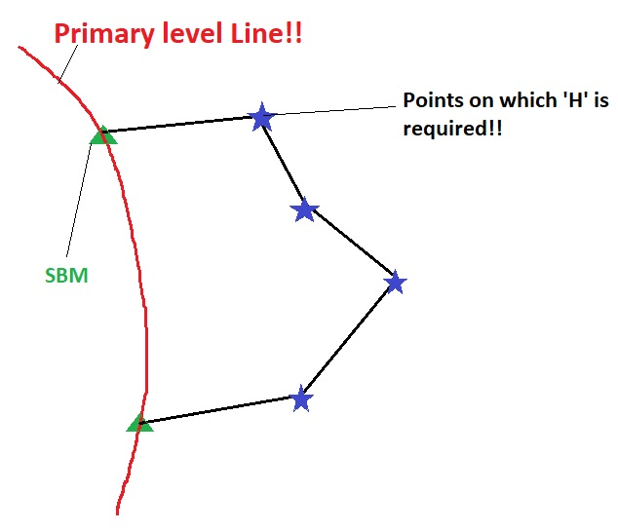
Saving money with a geoid model
Lets Consider a typical case:
  To establish a height control at 4 stations which are 25km (say) apart (as shown)
  Total leveling to be
  done (DT) = 125 km
  Approximate cost 8,00,000/-
  Approx Time = 1 month
  GPS and Geoid:
    Time: 4-5 days /Money: approx. 80,000/-
Savings: Rs 7,20,000 !!
So, Conservatively it can be said that GPS+Geoid will save at least 75-80% of both the Project cost & Time

Slide 8
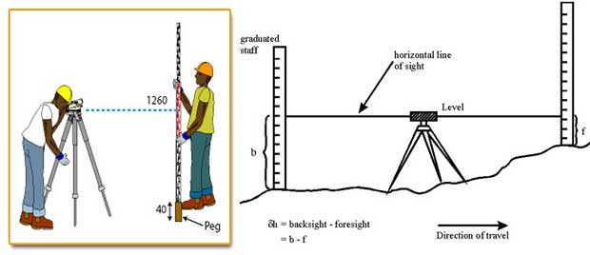
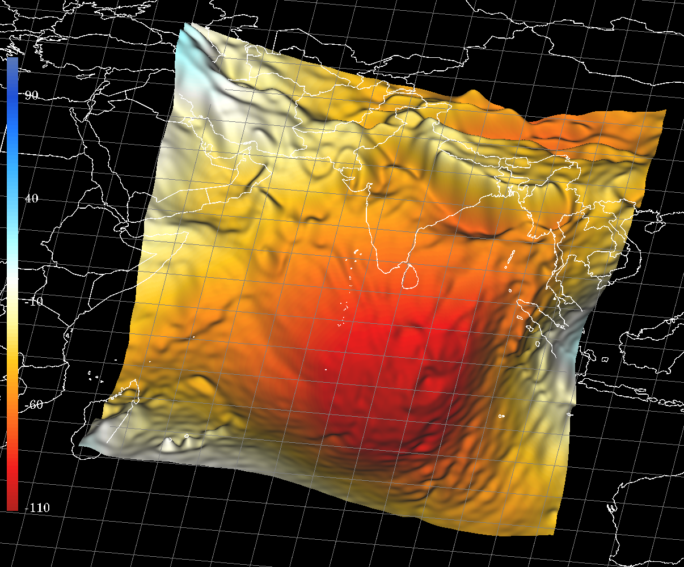
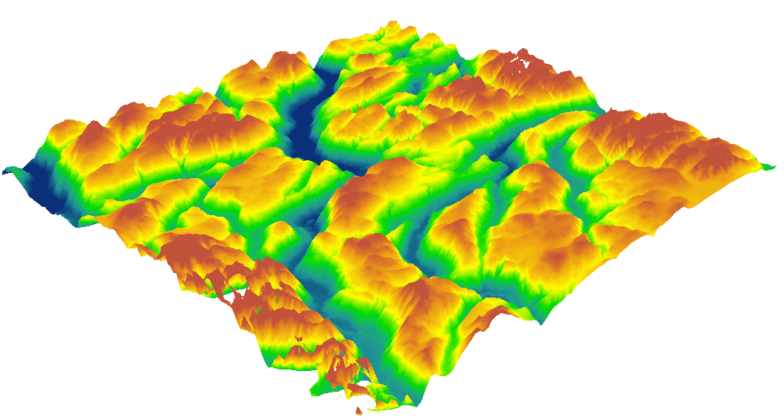
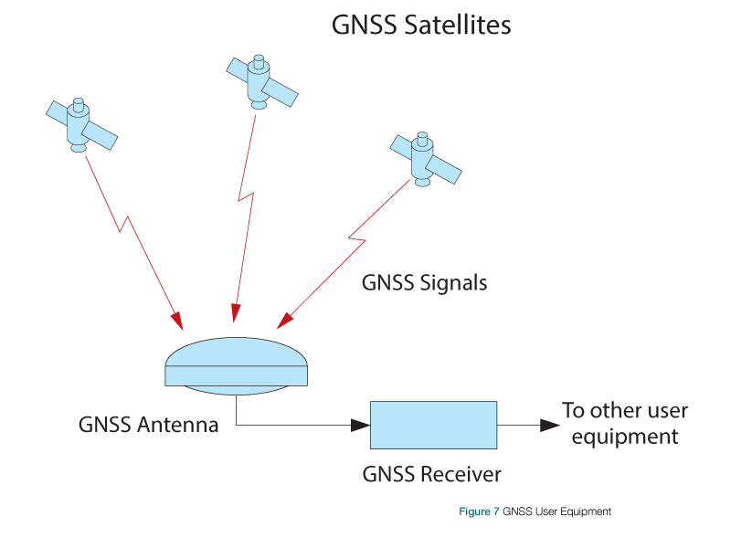
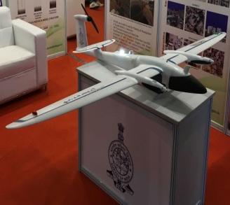
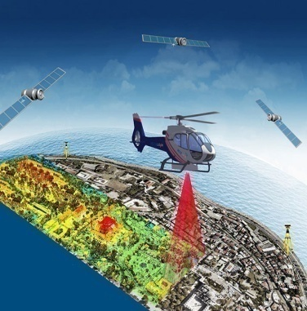
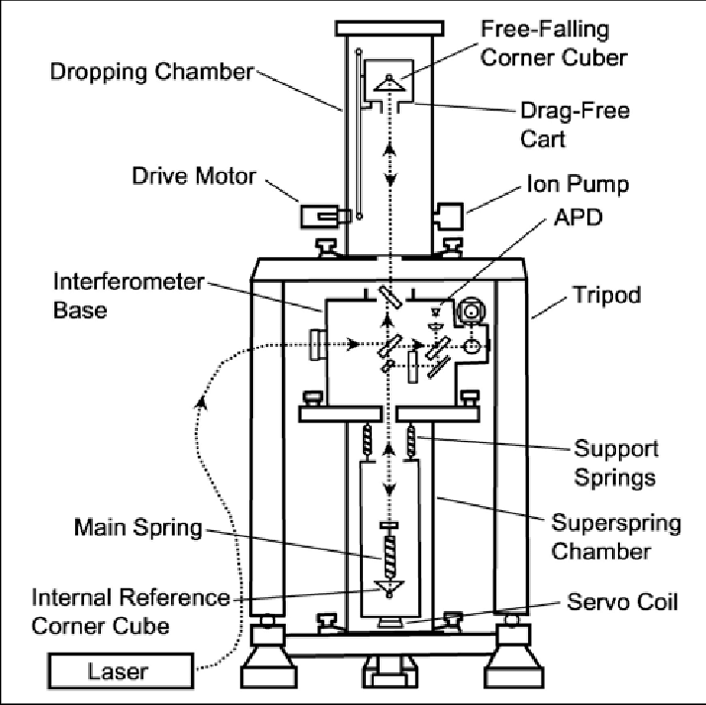
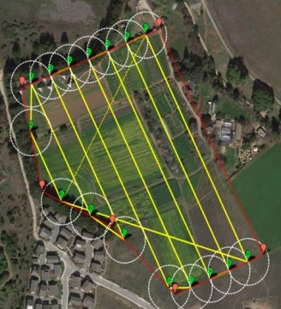
Geoid Model
Digital Elevation model
(Based on Orthometric Height)
+
OR
LiDAR Topographic Survey
Photogrammetric Survey

Slide 9
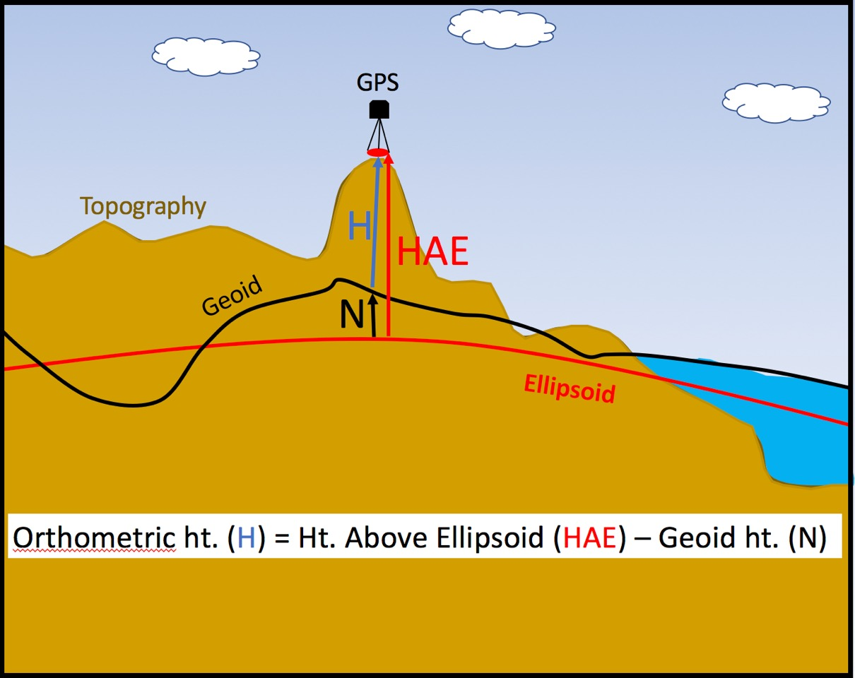

Slide 10
The many definitions of “height”
Orthometric Height (H)
  Height from the geoid to the Earth’s surface
  Frequently (informally) called “height above mean sea level”
  On most topographic maps
    e.g. “The Height of Mount Everest is 8848 meters”

Slide 12
The many definitions of “height”
Ellipsoidal Height (h)
  Height from the ellipsoid to the Earth’s surface
  Usually derived from GPS measurements
  Easy to obtain through GPS
  Has few physical applications
    e.g. water does not necessarily run ‘downhill’ in ellipsoid heights

Slide 13
The many definitions of “height”
Geoid Undulation(N)
  Height from ellipsoid up to geoid
  N = h – H
  “N” determined from gravity measurements

Slide 14
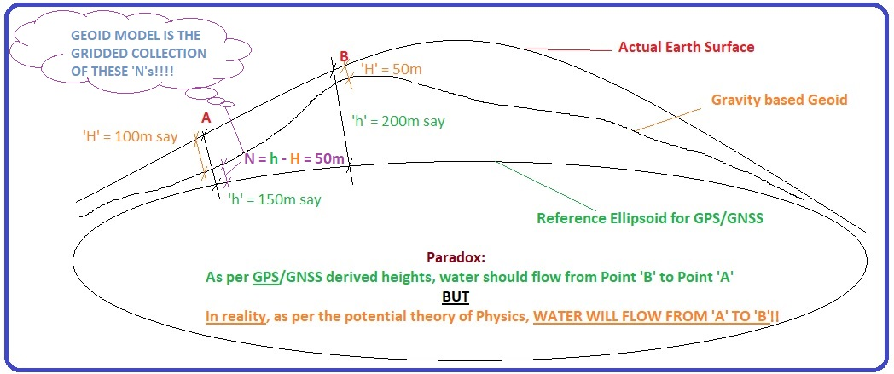

Slide 15
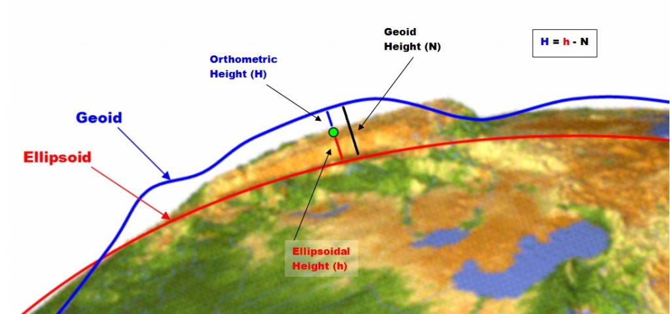

Slide 16
Geoid Modelling
What all we NEED to create a High Resolution Geoid!

Slide 17
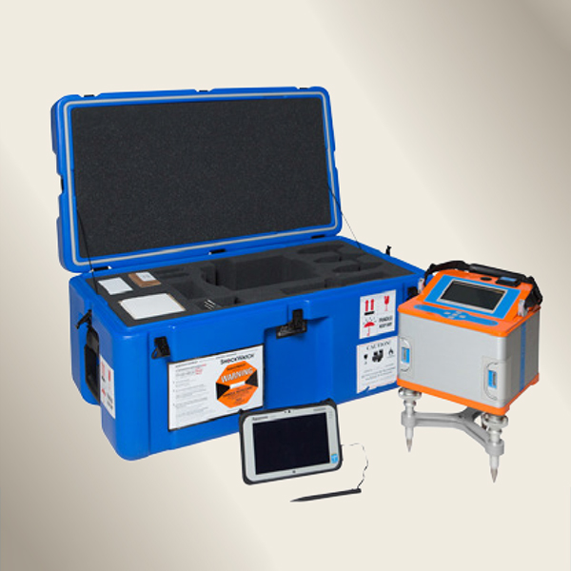
Instruments Used
CG-6 Autograv™ Gravity Meter, Scintrex

Slide 18
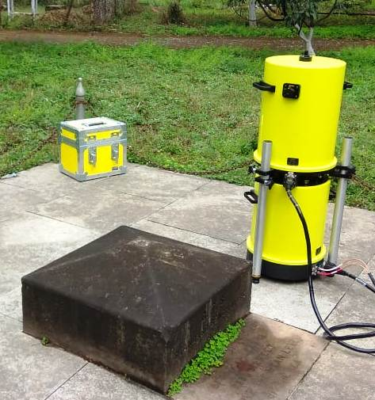
Instruments Used
A10 Portable Absolute Gravity Meter,
Micro g LaCoste

Slide 19
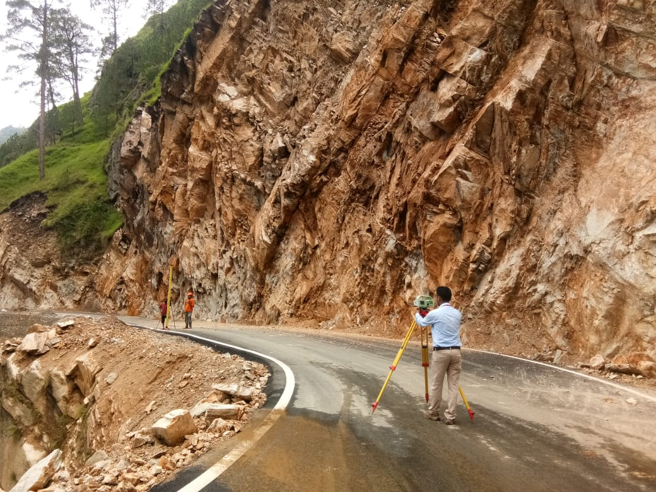
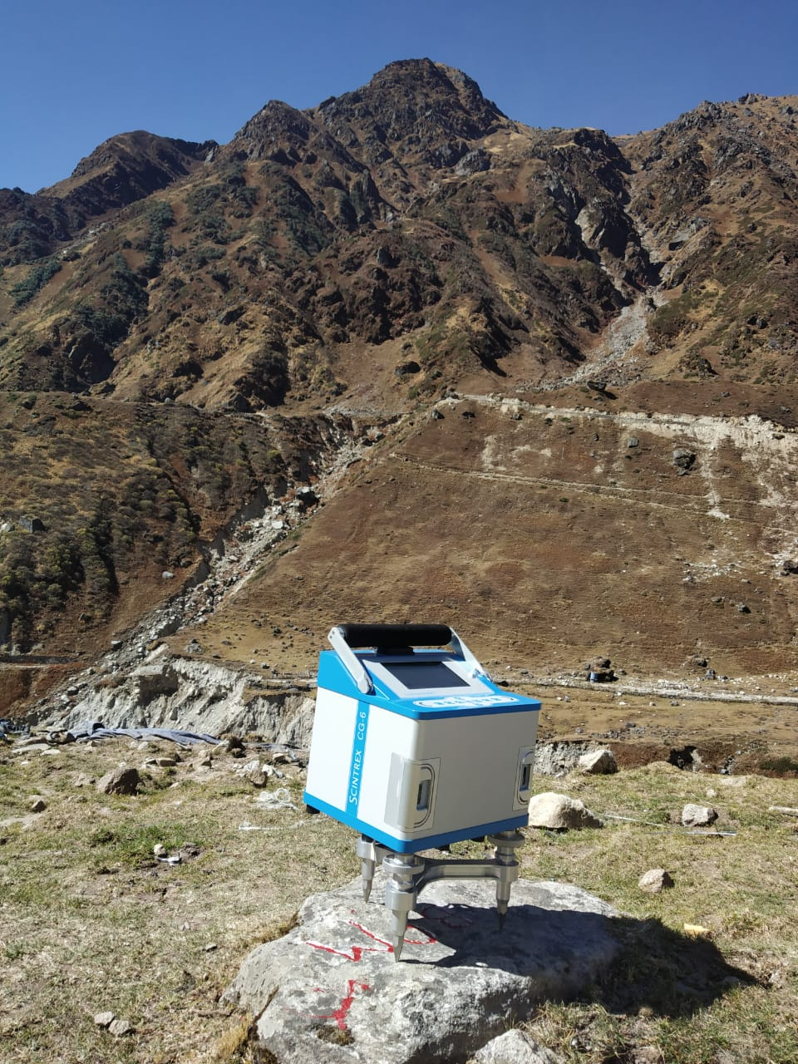
Survey Teams executing
High Precision Levelling
Gravity Observation

Slide 20
Data Requirement
Field Observation Data
Terrestrial gravity data i.e. well distributed free air anomaly in an around the area of interest.
Well distributed data of GNSS observations on Bench Marks connected to the High Precision IVD 2009 in the area.
N = h - H
Other Data
A suitable Global Geo-potential Model like EGM96, EGM2008 etc.
http://icgem.gfz-potsdam.de/tom_longtime
A high-resolution digital elevation model (DEM) for computation of terrain effects.

Slide 21
Software Requirement
GRAVSOFT
GRAVSOFT is a package of FORTRAN programs for gravity field modelling
The specific use of the programs is for the determination of the empirical covariance function and its analytic modelling and geoid determination using least-squares collocation

Slide 22
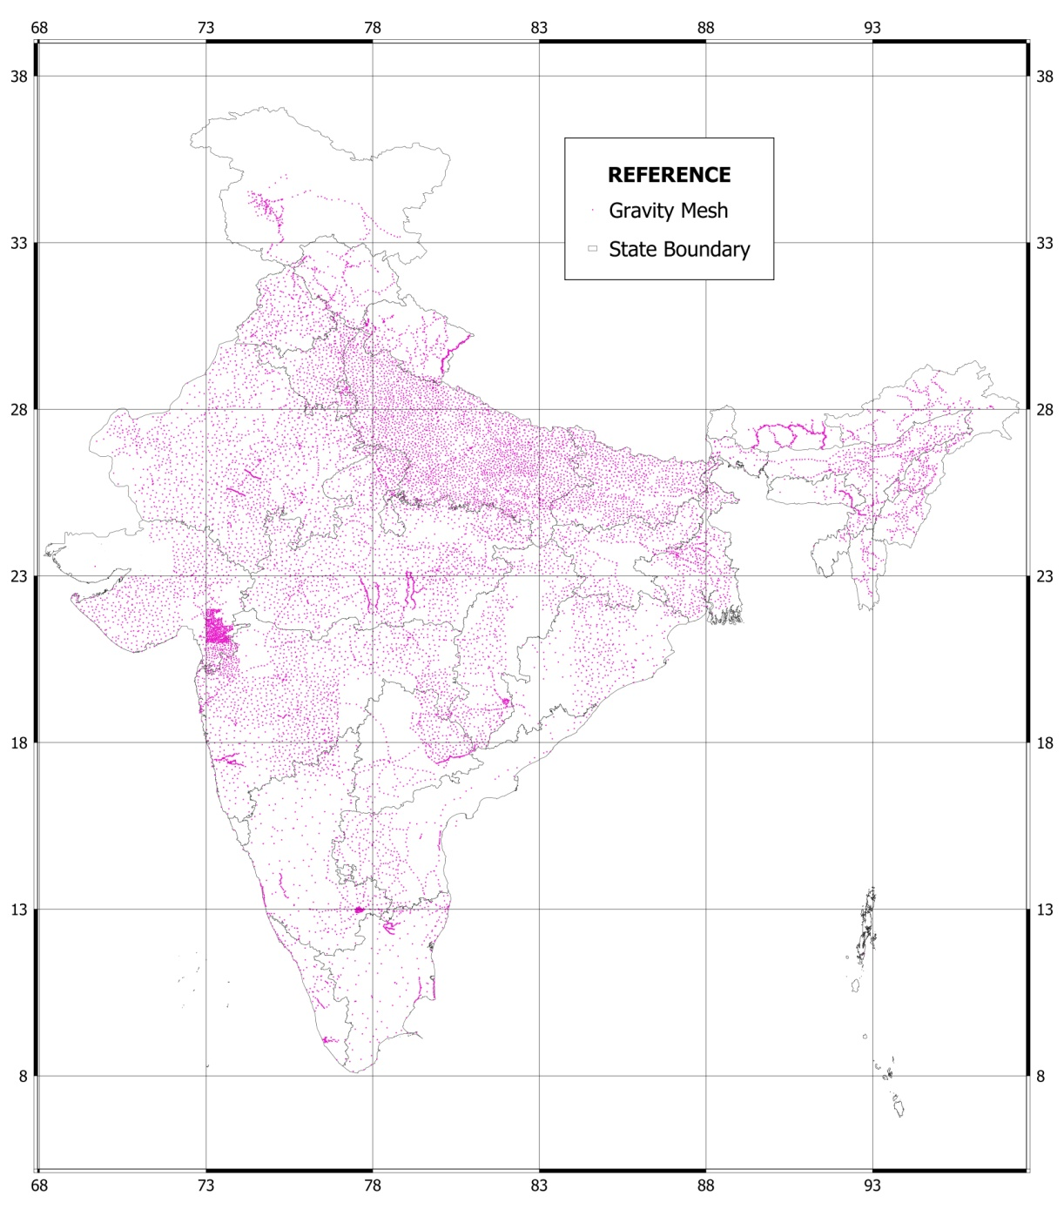
Data Available with Survey of India
Gravity Coverage
About 29000 observed gravity points

Slide 23
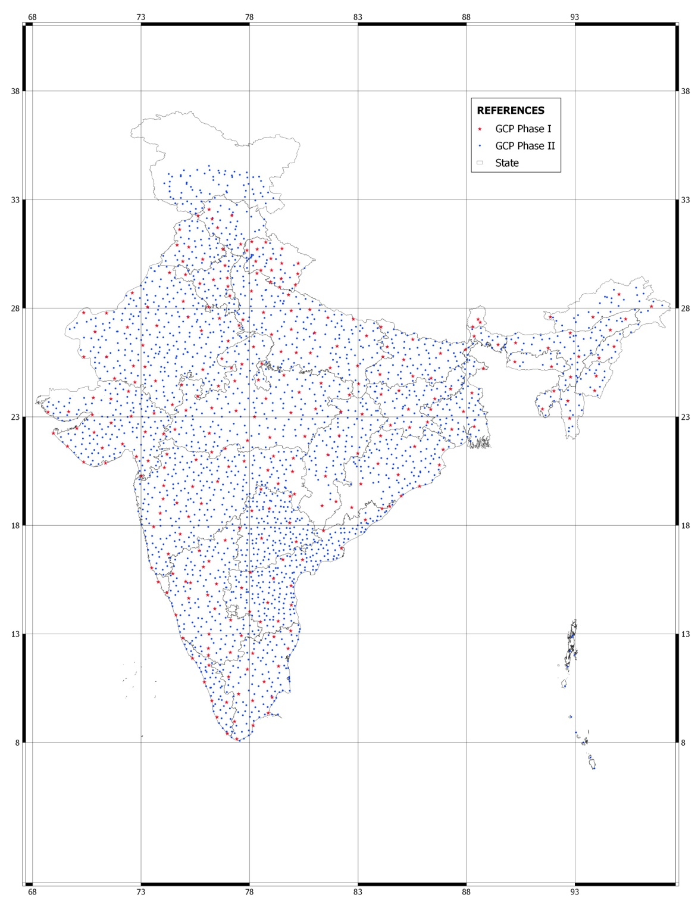
GCP Network
About 2520 observed GCP points

Slide 24
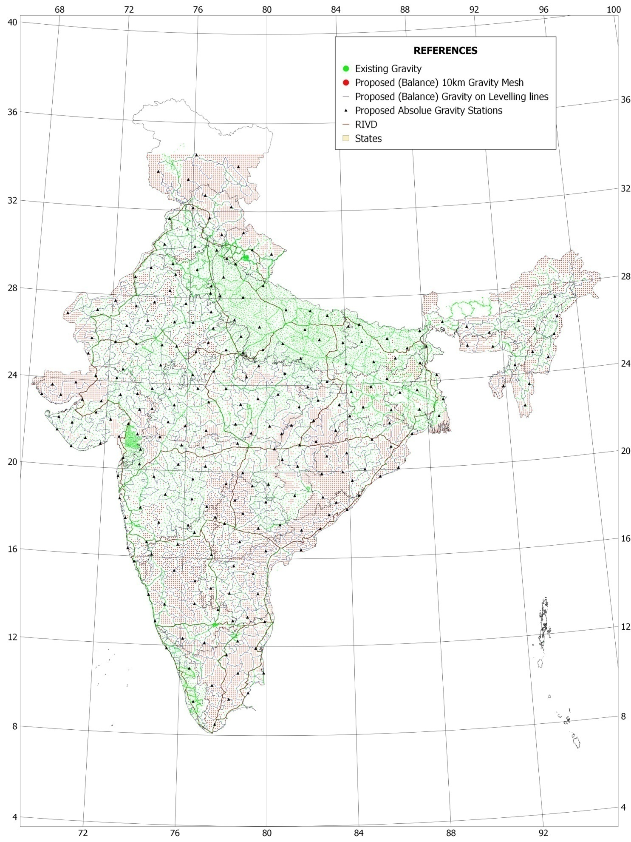
All India Gravity
cum
Leveling Coverage

Slide 25
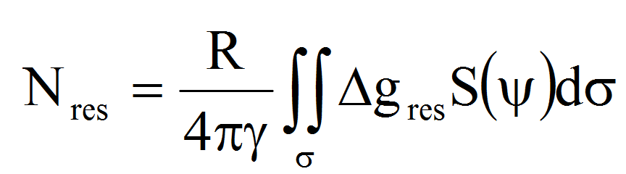
Overview of Methodology
Widely adopted RCR (Remove-Compute-Restore) method has been used to develop a Geoid Model.
REMOVE STEPS
Residual FA, Δg_{res} = Δ g_{FA} - Δ g_{TC/RTM} - Δg_{ggm}
COMPUTE STEPS
RESTORE STEPS
N = N_{res} + N_{GGM} + N_{t}

Slide 26
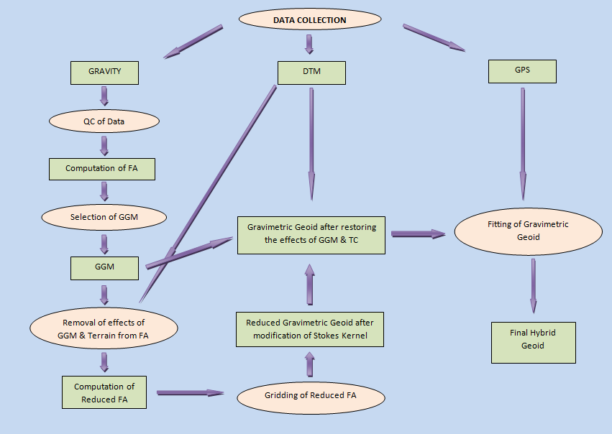
Process Flow Chart

Slide 27
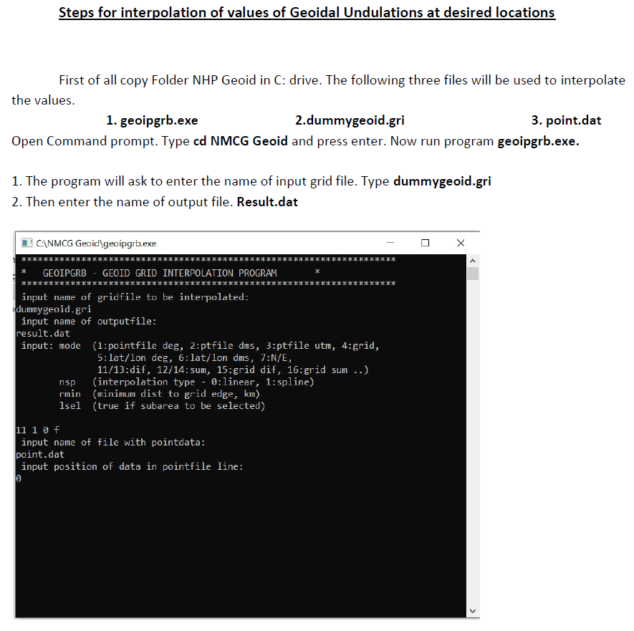

Slide 28
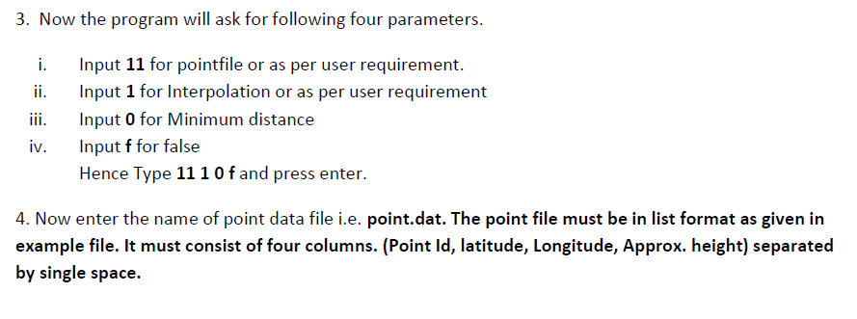
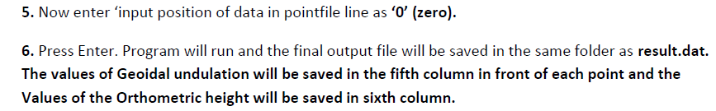

Slide 29
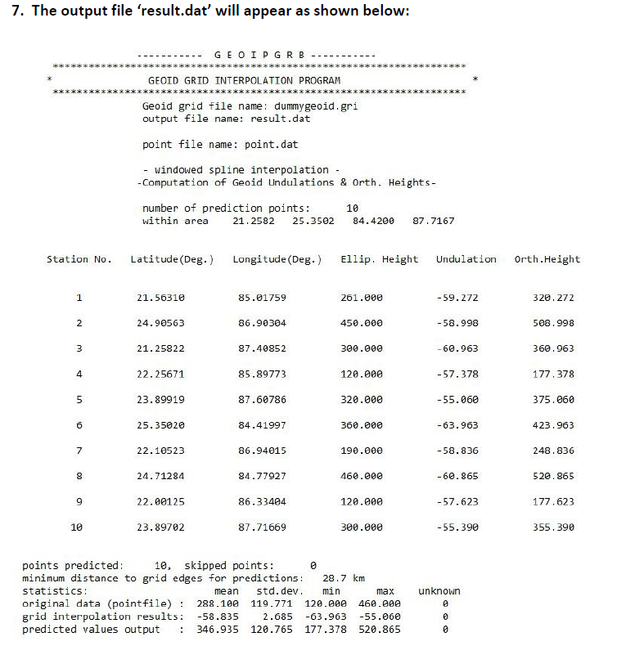

Slide 30
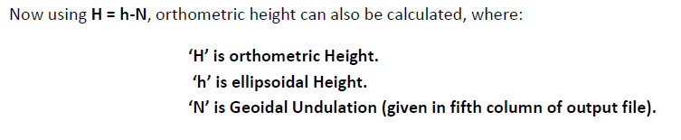

Slide 31
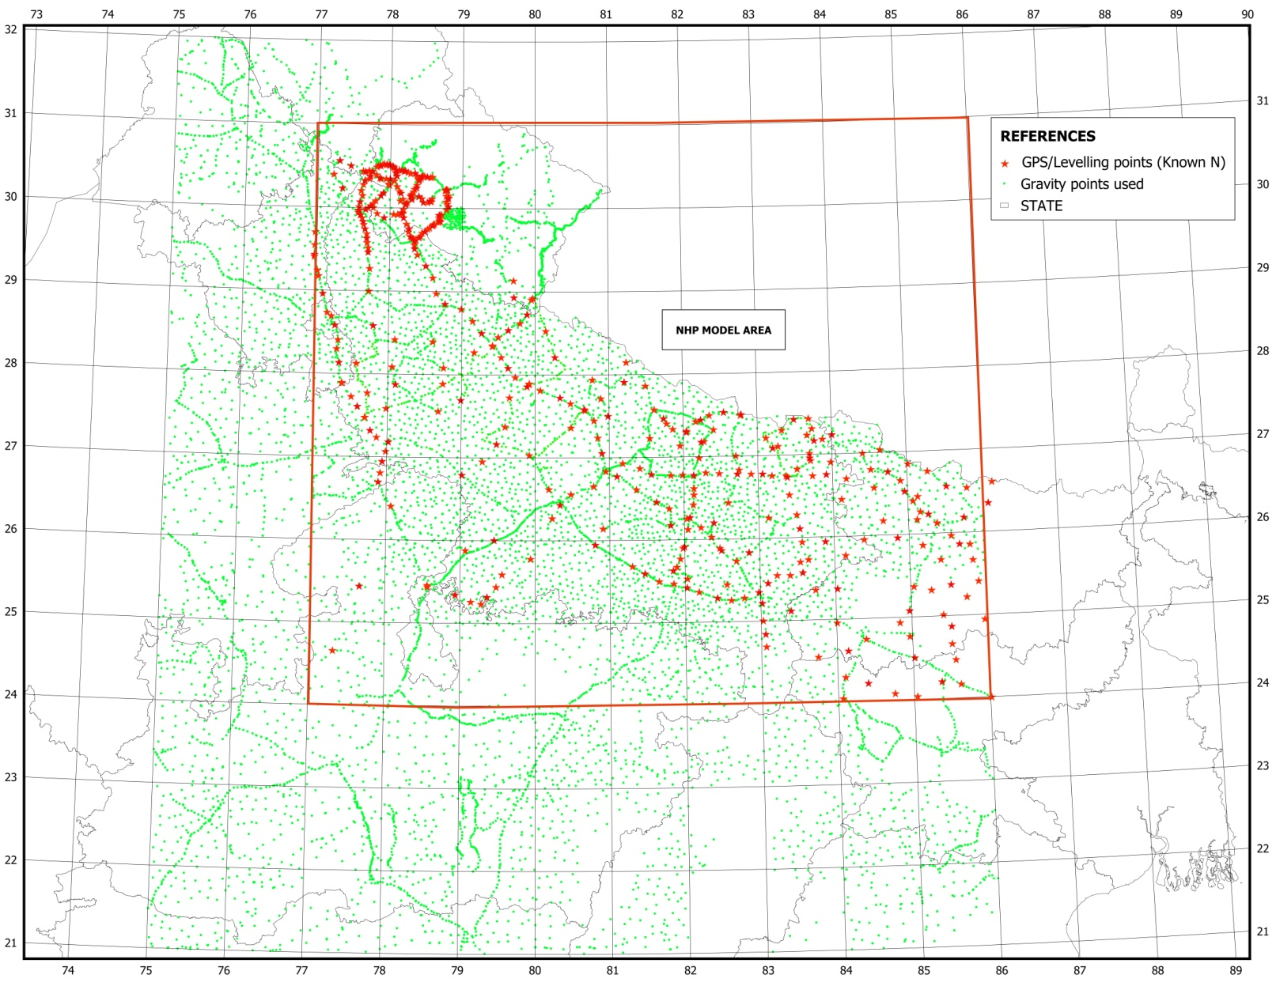
UP Geoid Model

Slide 32
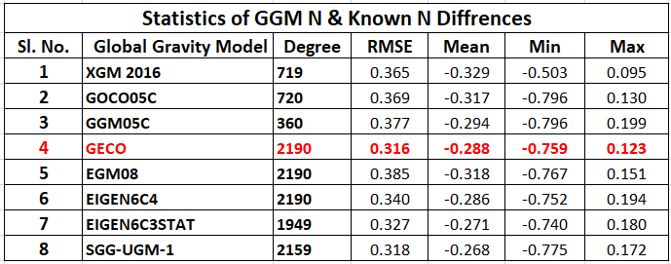
Selection of GGM
  We require a suitable Global gravity Model which is best fitting to the area of interest.
  This can be selected by comparing RMSE’s of difference of GGM’s N & observed N.

Slide 33
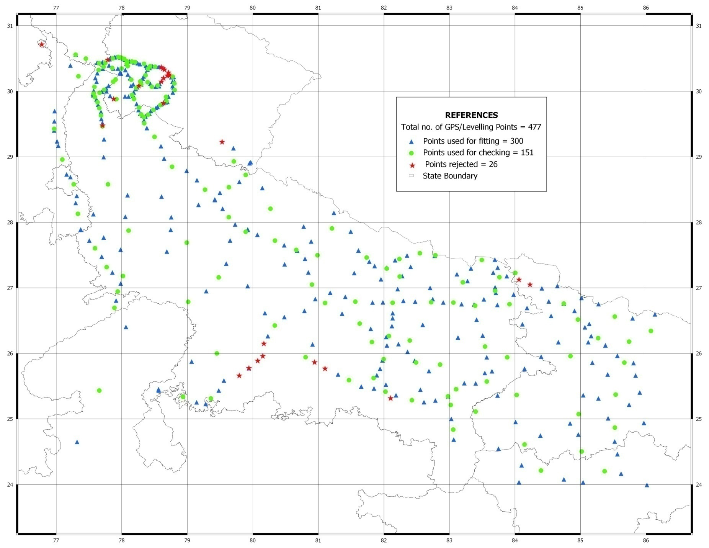
  Distribution of Points used
  for fitting & checking of Geoid

Slide 34
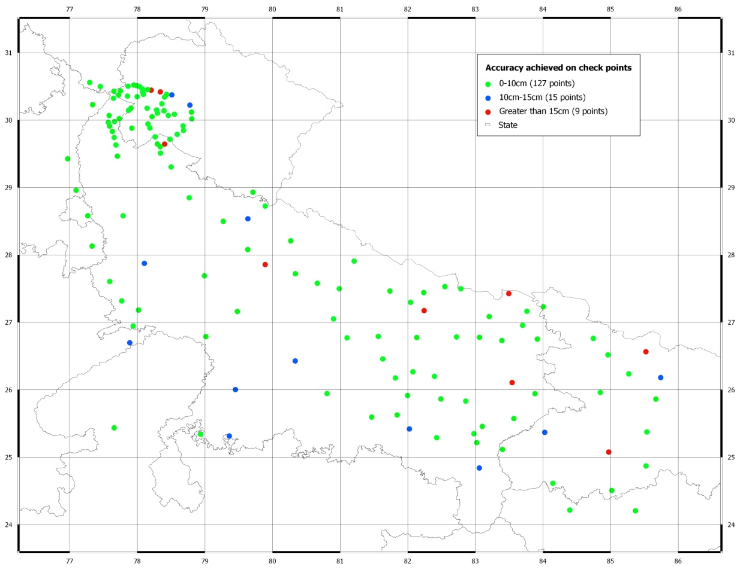
  Accuracy Achieved On Check Points

Slide 35
  Accuracy Achieved On Check Points

Slide 36
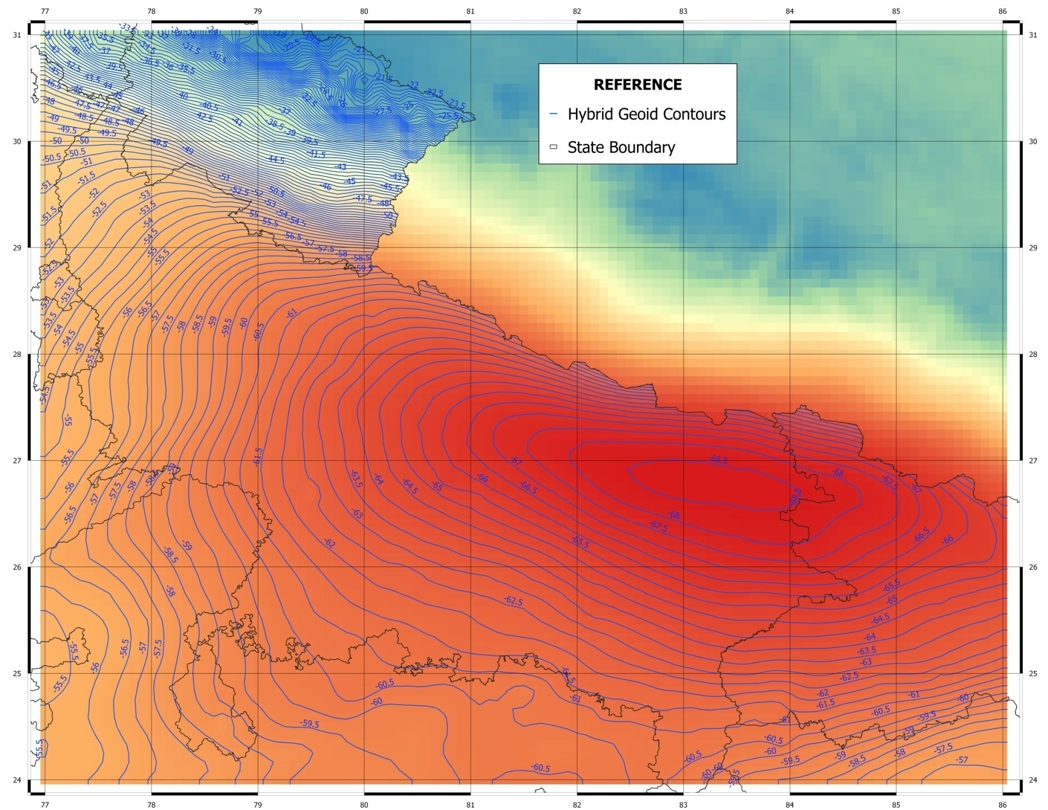
UP Hybrid Geoid

Slide 37
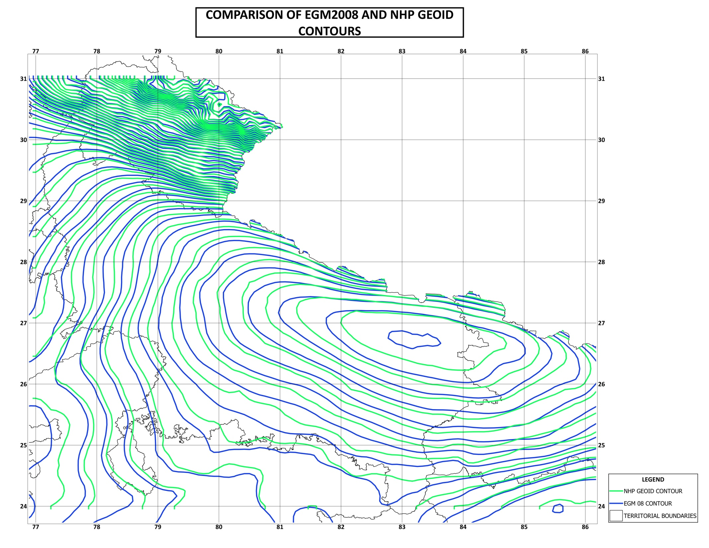
Comparision Between IndGeoid
&
EGM2008
COMPARISON OF EGM2008 &
UP GEOID CONTOURS

Slide 38
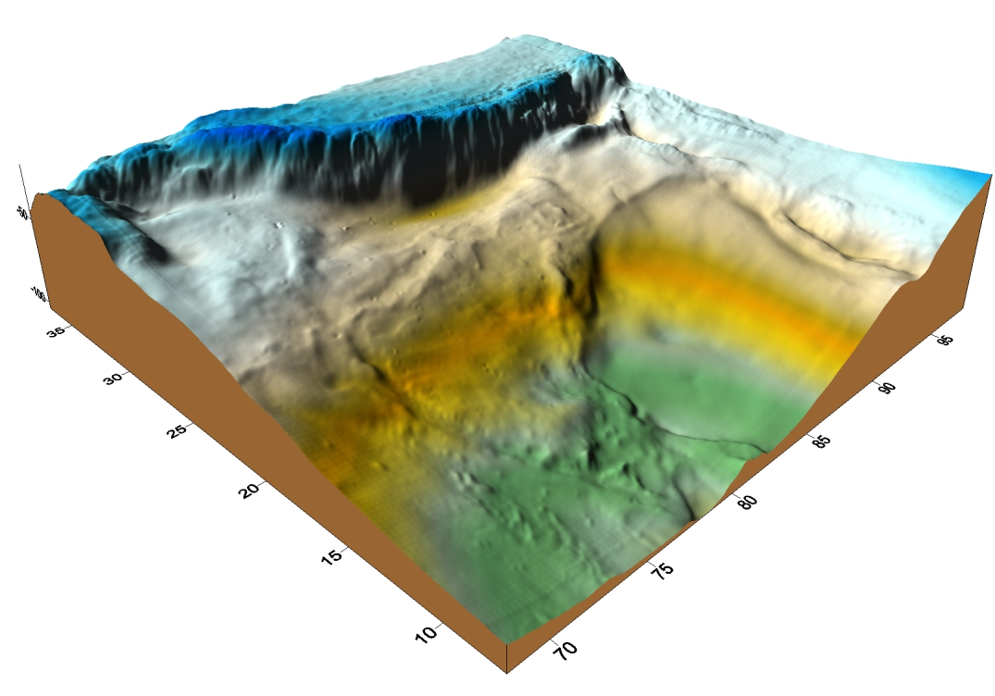
3D View

Slide 39
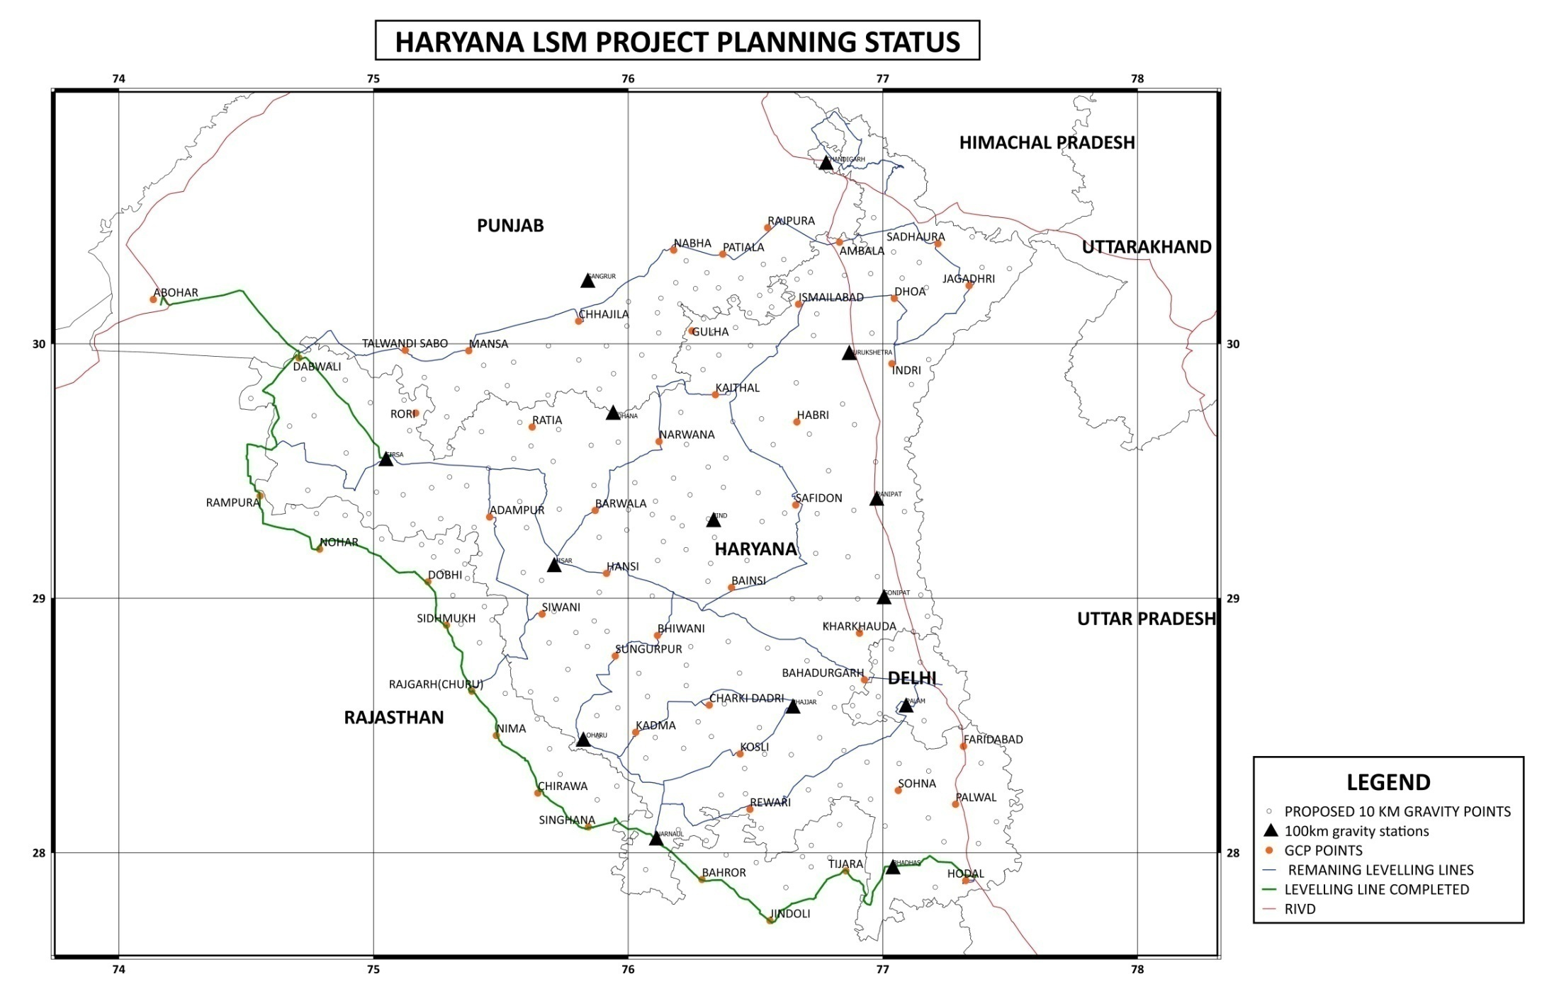
Ongoing Projects

Slide 40
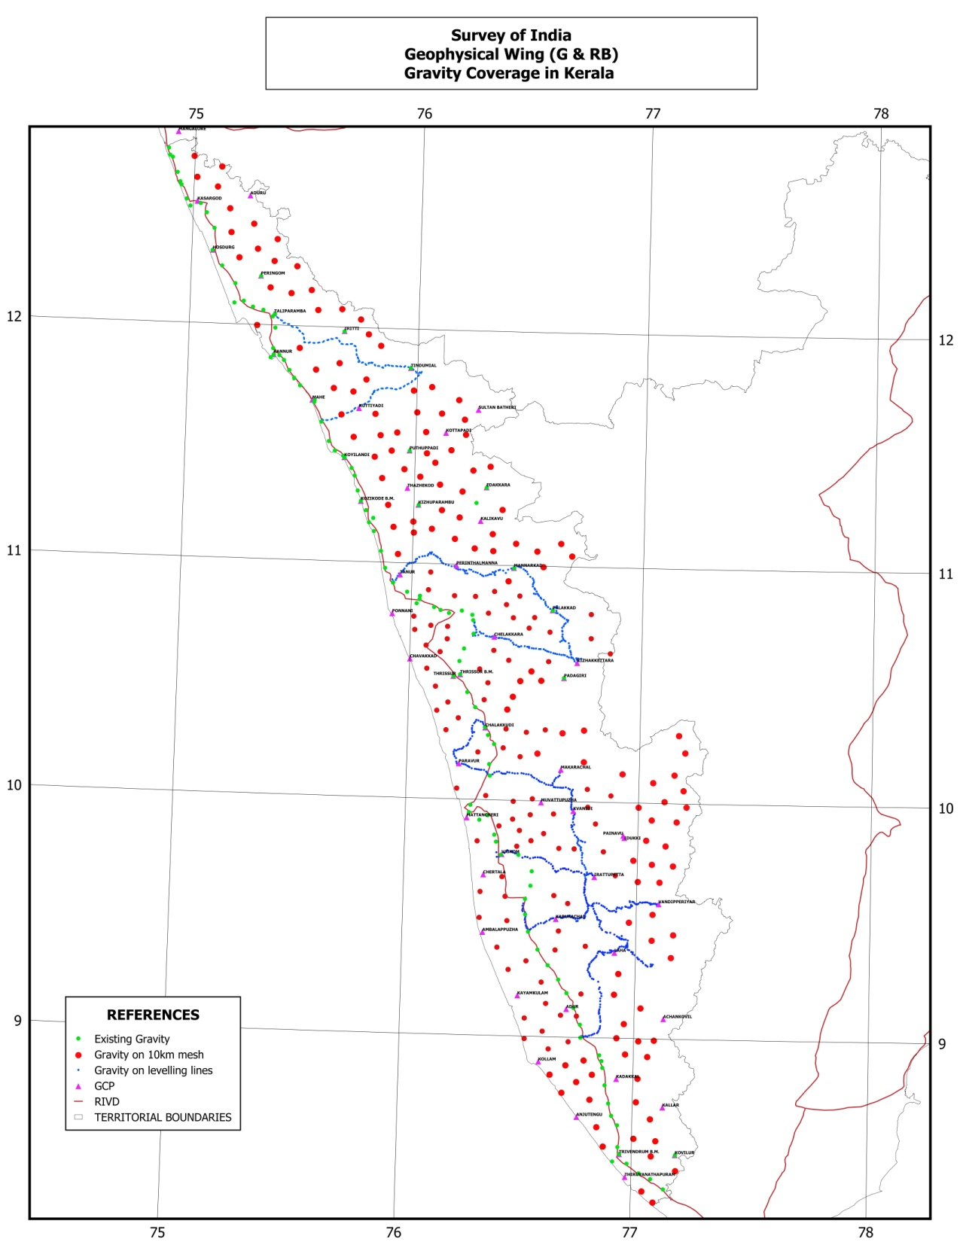
Flood Level Marking
Project, Kerala
[Geoid Model Development is in progress!!]

Slide 41
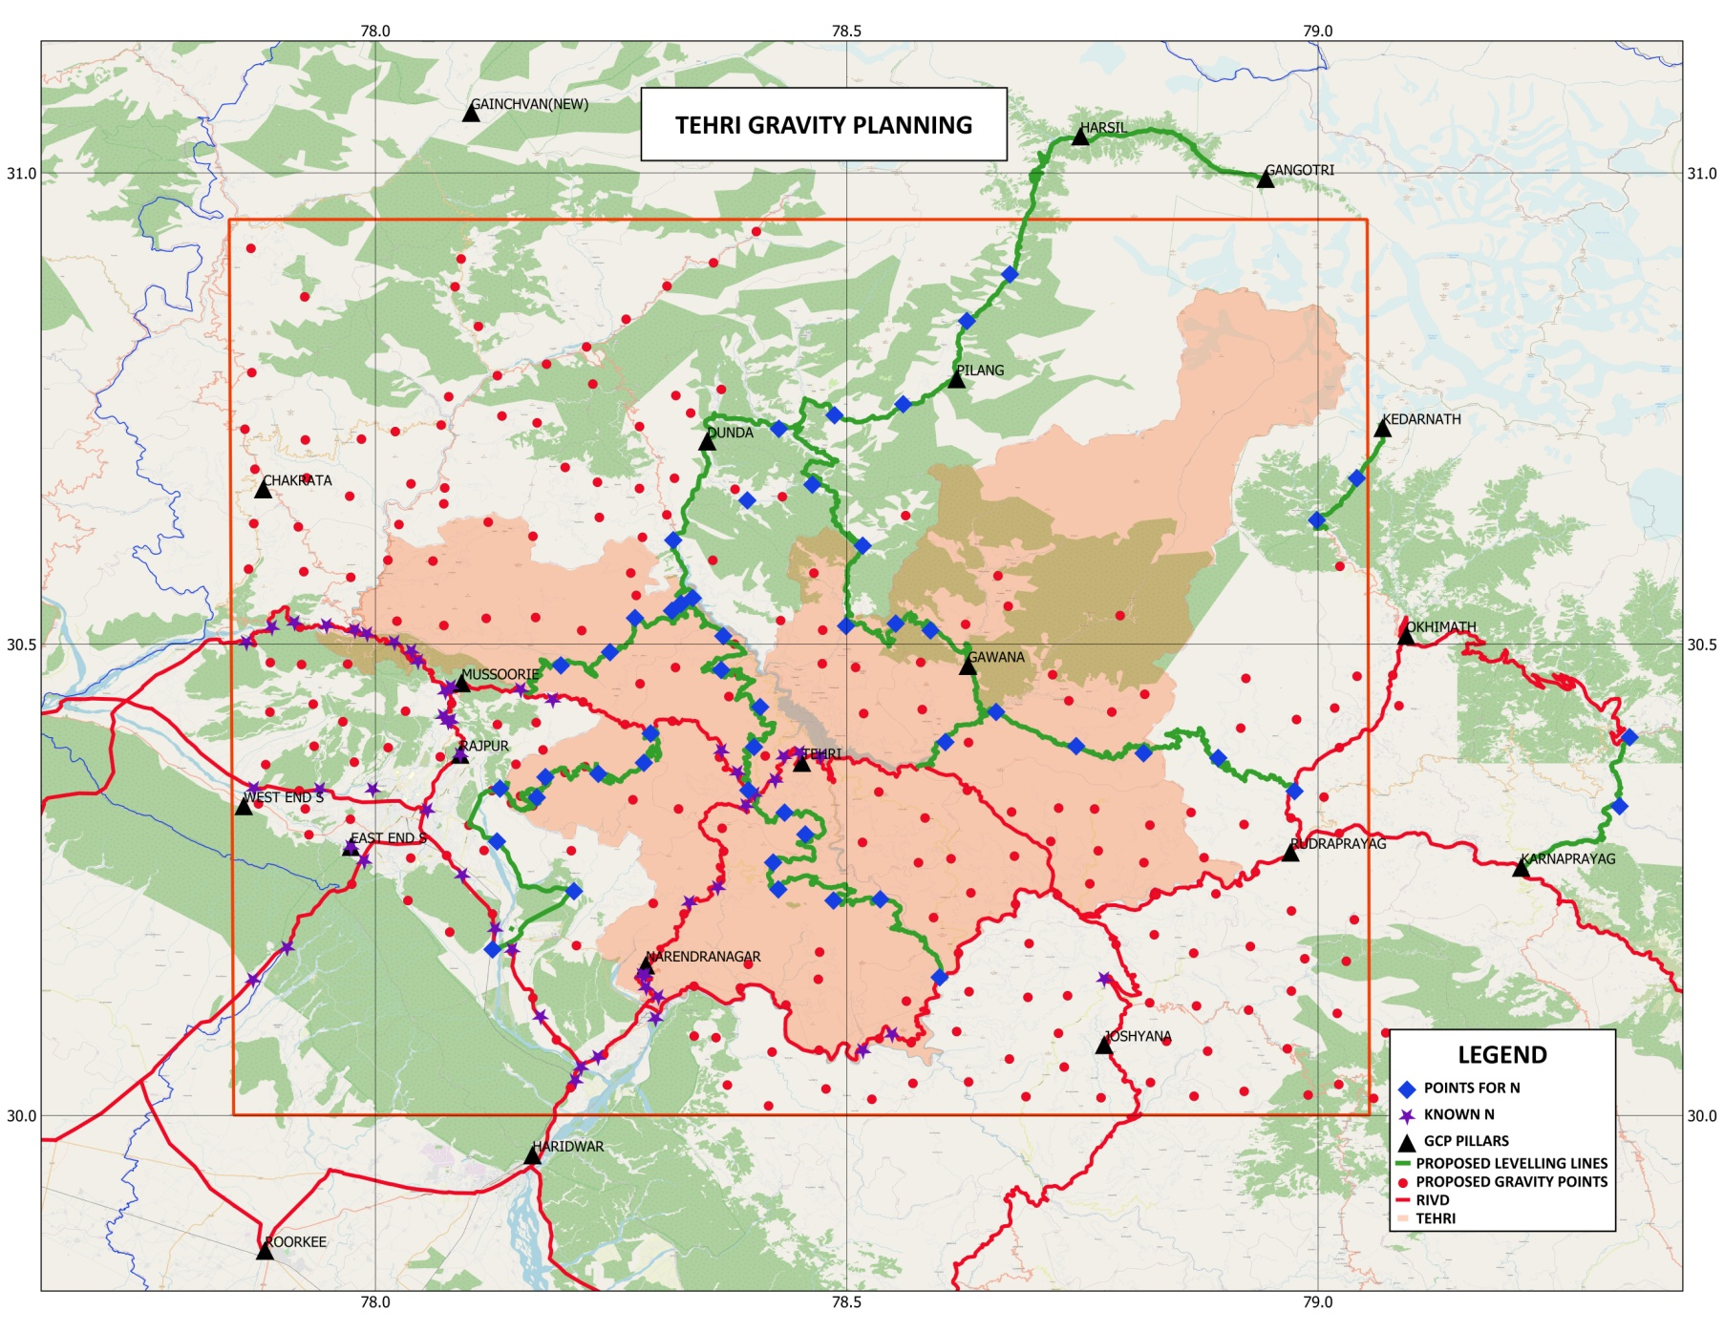
Tehri Garhwal, Uttarakhand

Slide 42
Conclusion
As it is clear that for a large projects like NHP, NMCG, LSM, Swamitva, etc., the usefulness of a Geoid Model is immense.
It has been clearly established that the high resolution data over an area increases the accuracy by nearly 50% (in case of NHP).
It hugely reduces the COST & TIME by nearly 75-80%!!
It will definitely facilitate GNSS user community to derive Faster & Cheaper Orthometric heights.
It will be a boon for the subsurface investigation & mapping by providing the accurate Heights in time bound & cost efficient manner!

Slide 43
Thank you!!
Any Questions?

